Slide 1
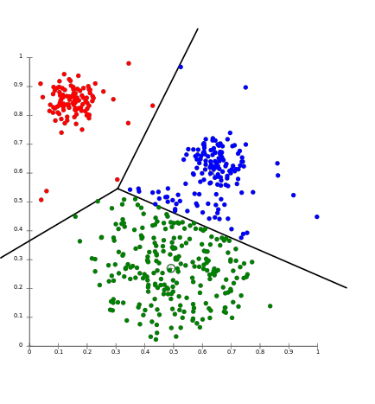
Customer Segmentation using K-means Clustering using Python
Presented By: - Aman Kumar (1NT19CS024)
Amreshwar Singh(1NT19CS026)
Aryan Burman (1NT19CS039)
Chandranshu Jha (1NT19CS058)

Slide 2
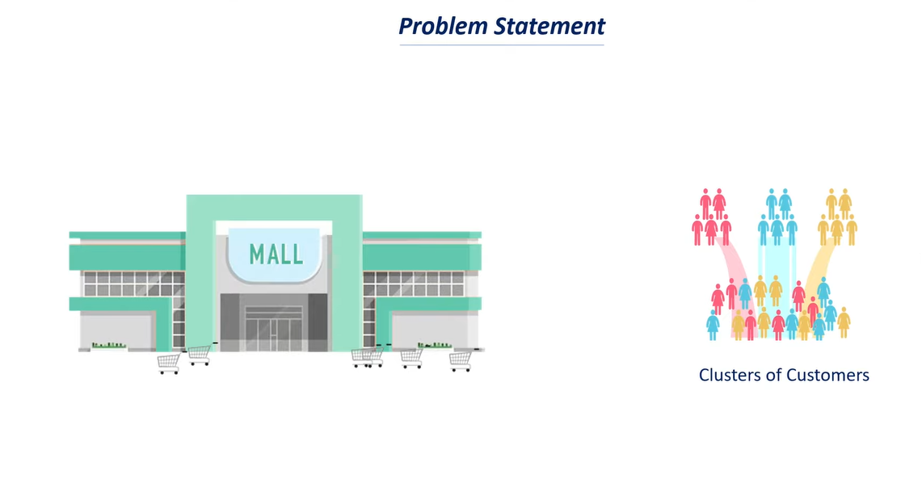
Consider that there is a mall and we are a data scientist and with the help of customer data, the mall needs to know the customer behaviour about what they want to buy and how frequent do they buy from the mall. Build a system that can cluster customers into different groups with same products or frequency of buying things from mall, so that they can make better market strategies and implement business ideas

Slide 3
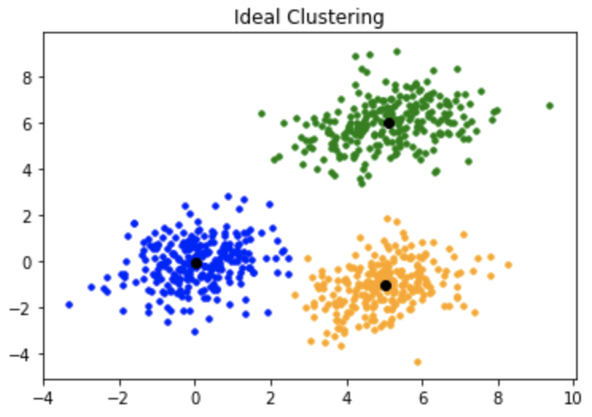
What is K-mean clustering????

Slide 4
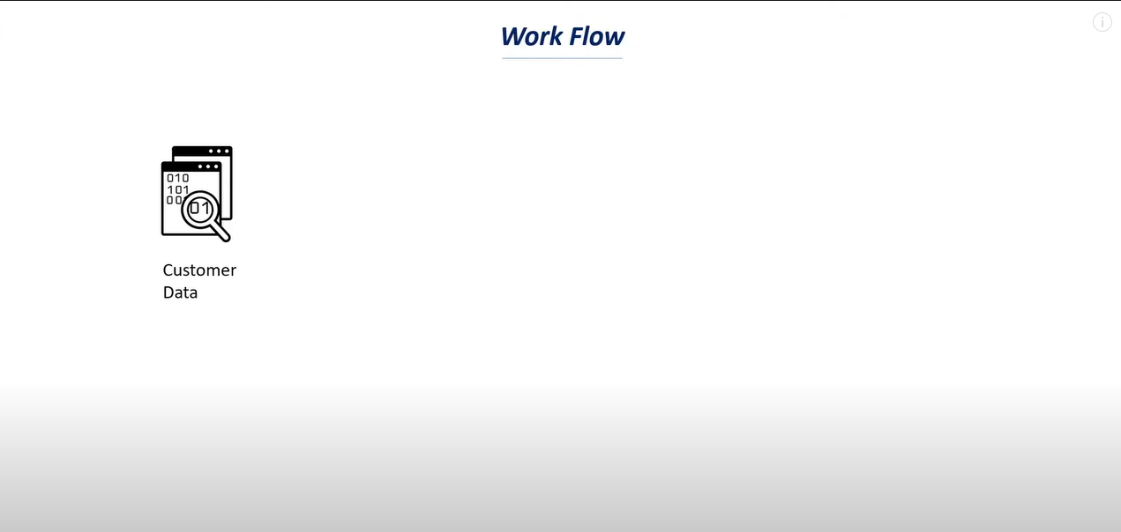

Slide 5
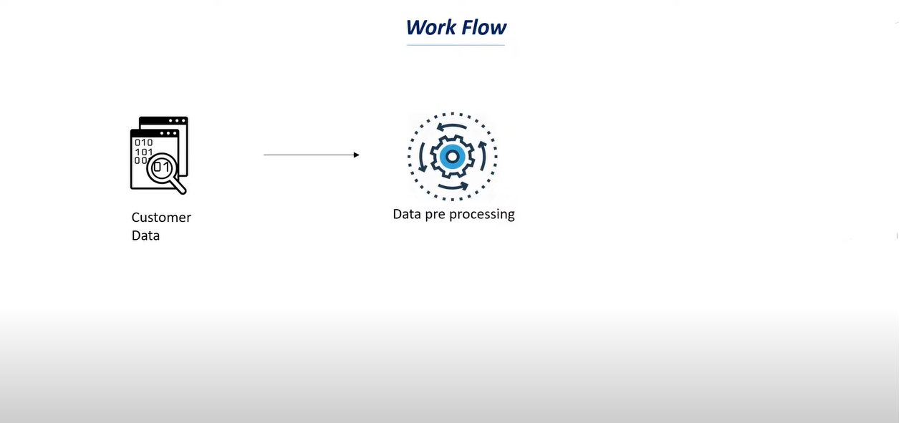

Slide 6
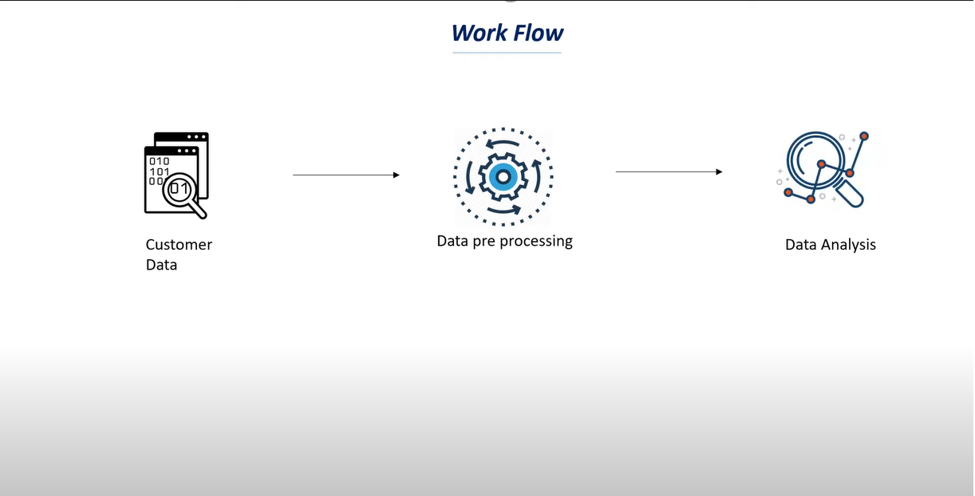

Slide 7
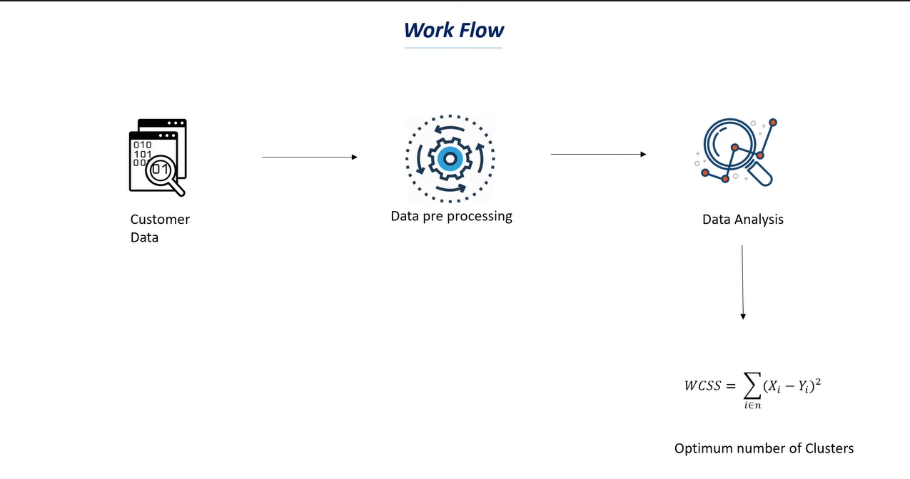

Slide 8
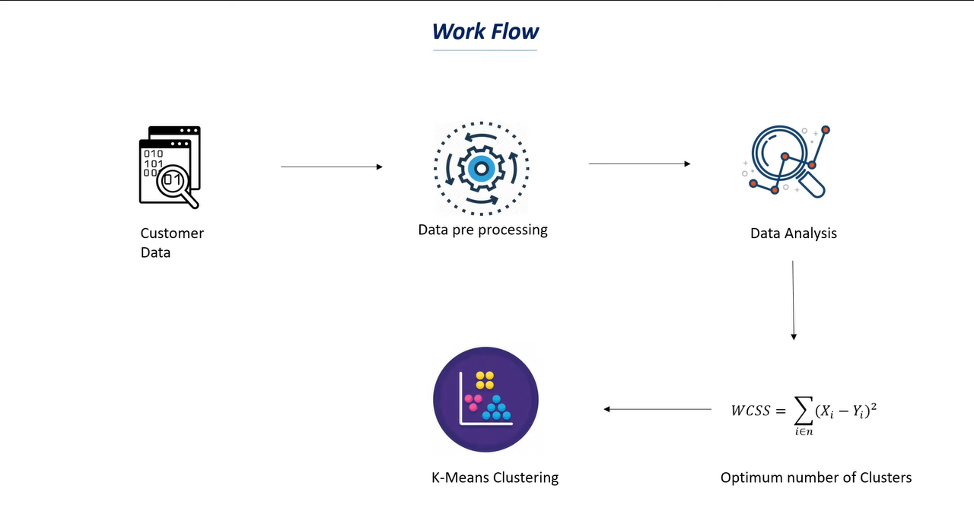

Slide 9
